Slide 1
DETERMINANTS OF SOCIAL CONFLICTS IN NORTH-EASTERN UGANDA AND NORTH-WESTERN KENYA.
Derick Ansyijar Kuule
PhD Student
Department of Environmental Management, Makerere University
Proposed co-authors: Alice Turinawe, Anthony Egeru, Barbara Schumann, Göran Bostedt, Stephen Mureithi, Denis Mpairwe & Ingrid Öborn
Supervisors: Anthony Egeru, Alice Turinawe & Barbara Schumann
Doctoral committee: Anthony Egeru, Alice Turinawe, Barbara Schumann, Kristina Lindvall & Göran Bostedt

Slide 2
Research Questions and Hypothesis
What forms of social conflicts occur at the household and community level
How do household socio-economic resources influence social conflict occurrence
Does seasonality in ecological resources influence household-level social conflicts in the study region
How does rainfall seasonality influence the forms and patterns of social conflicts?
Hypothesis:
Social conflicts are mediated by household and community socio-ecological characteristics and rainfall seasonality

Slide 3
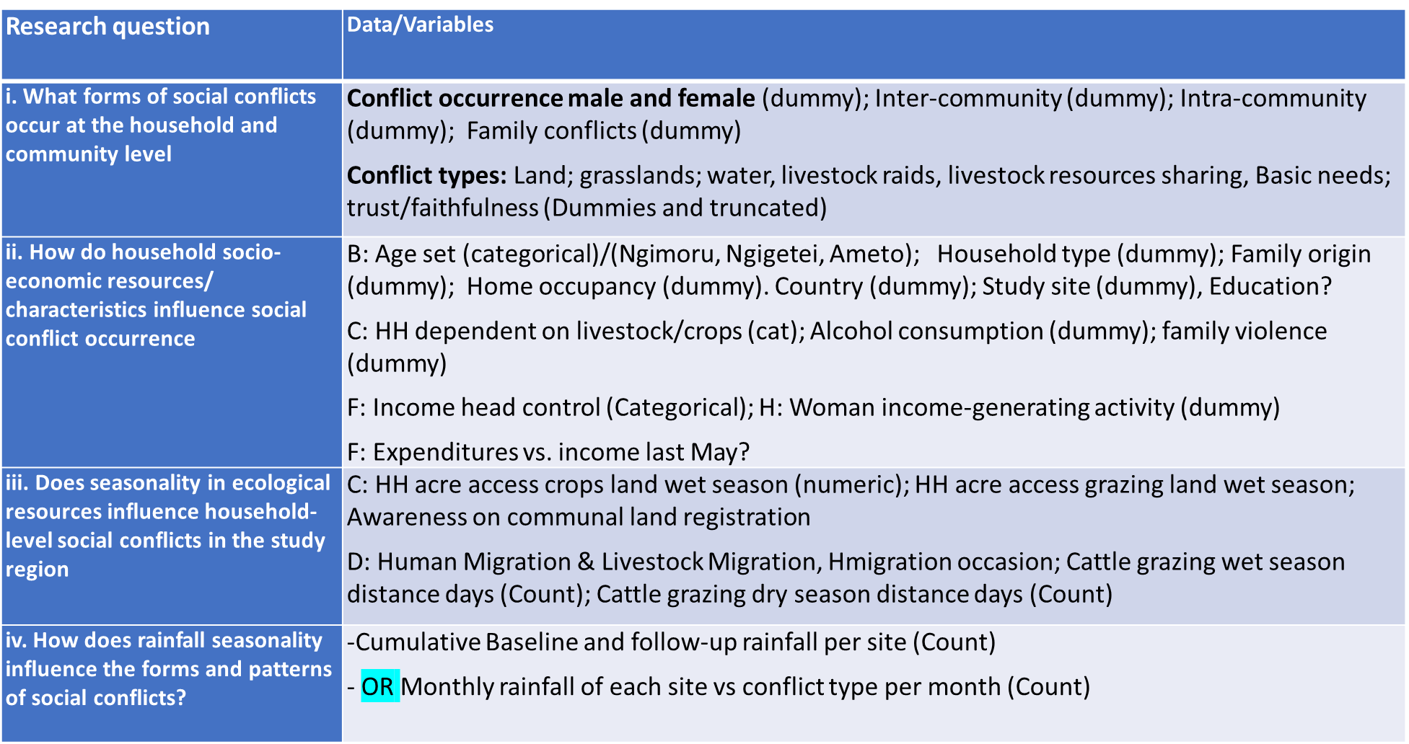
Data collection and Analysis methods

Slide 4
Data collection and Analysis methods
Type of Data | Data collection method | Data analysis method | Data source
Occurrence of Social Conflicts & determinants | Structured interviews | Binary response model (Probit) | Baseline and follow-up survey data
Forms of social conflicts & determinants | Structured interviews | Multivariate regression Analysis | Baseline and follow-up survey data
Seasonality of social conflicts | Satellite data Structured interviews | Descriptive statistics Pearson correlations analysis | NASA Power satellite rainfall

Slide 5
Preliminary results
Male conflict occurrence | Freq. | Percent
No | 424 | 44.92
Yes | 520 | 55.08
Total | 944 | 100
 |  | Studysite
Male conflict occurrence | Chepareria | Lokiriama | Matany | Rupa | Total
No | 171 | 114 | 84 | 55 | 424
Yes | 51 | 89 | 146 | 234 | 520
Total | 222 | 203 | 230 | 289 | 944
Conflict level
Male conflict occurrence | Inter-community | Intra-community | Family
No | 598 (63.4% | 761 (80.6%) | 738 (78.2%)
Yes | 346 (36.7%) | 183 (19.4%) | 206 (21.8%)
 | 944 | 944 | 944
Inter-community conflicts | Raids | Grasslands | Water | Livestock | Land
NO | 13.3 | 87.3 | 91.0 | 90.2 | 91.9
YES | 86.7 | 12.7 | 9.0 | 9.8 | 8.1
 | 100 | 100 | 100 | 100 | 100
Intra-community | Intra-community | Grassland | Water | Livestock
No | 87.43169 | 90.71038 | 83.06011 | 72.13115
Yes | 12.56831 | 9.289617 | 16.93989 | 27.86885
 | 100 | 100 | 100 | 100
Female conflicts | Intra_community | Family
No | 840 (89%) | 725 (76.8%)
Yes | 104 (11%) | 219 (23.2%)
 | 944 | 944

Slide 6
Preliminary results cont.
Livelihood type |  | Studysite
HH dependence on agric | Chepareria | Lokiriama | Matany | Rupa | Total
Livestock-dependent | 10 | 143 | 3 | 12 | 168
Crop-dependent | 6 | 2 | 112 | 38 | 158
Both crop & livestock | 199 | 38 | 101 | 88 | 426
Other main source | 7 | 20 | 14 | 151 | 192
Total | 222 | 203 | 230 | 289 | 944
HH dependence on agric | Freq. | Percent
Livestock-dependent | 168 | 17.8
Crop-dependent | 158 | 16.74
Both crop & livestock | 426 | 45.13
Other main source | 192 | 20.34
Total | 944 | 100
Migration with livestock
Male conflict occurrence | No | Yes | 888 | Total
No | 200 | 140 | 84 | 424
Yes | 116 | 249 | 155 | 520
Total | 316 | 389 | 239 | 944
 |  | Studysite
Livestock migration | Chepareria | Lokiriama | Matany | Rupa | Total
No | 173 | 60 | 38 | 45 | 316
Yes | 43 | 138 | 94 | 114 | 389
888 | 6 | 5 | 98 | 130 | 239
Total | 222 | 203 | 230 | 289 | 944
Male conflict occurrence
Human migration | No | Yes | Total
No | 353 | 319 | 672
Yes | 71 | 201 | 272
Total | 424 | 520 | 944
 |  | Study site
Human migration | Chepareria | Lokiriama | Matany | Rupa | Total
No | 206 | 117 | 189 | 160 | 672
Yes | 16 | 86 | 41 | 129 | 272
Total | 222 | 203 | 230 | 289 | 944

